Slide 1
Properties of Sorting

Slide 2
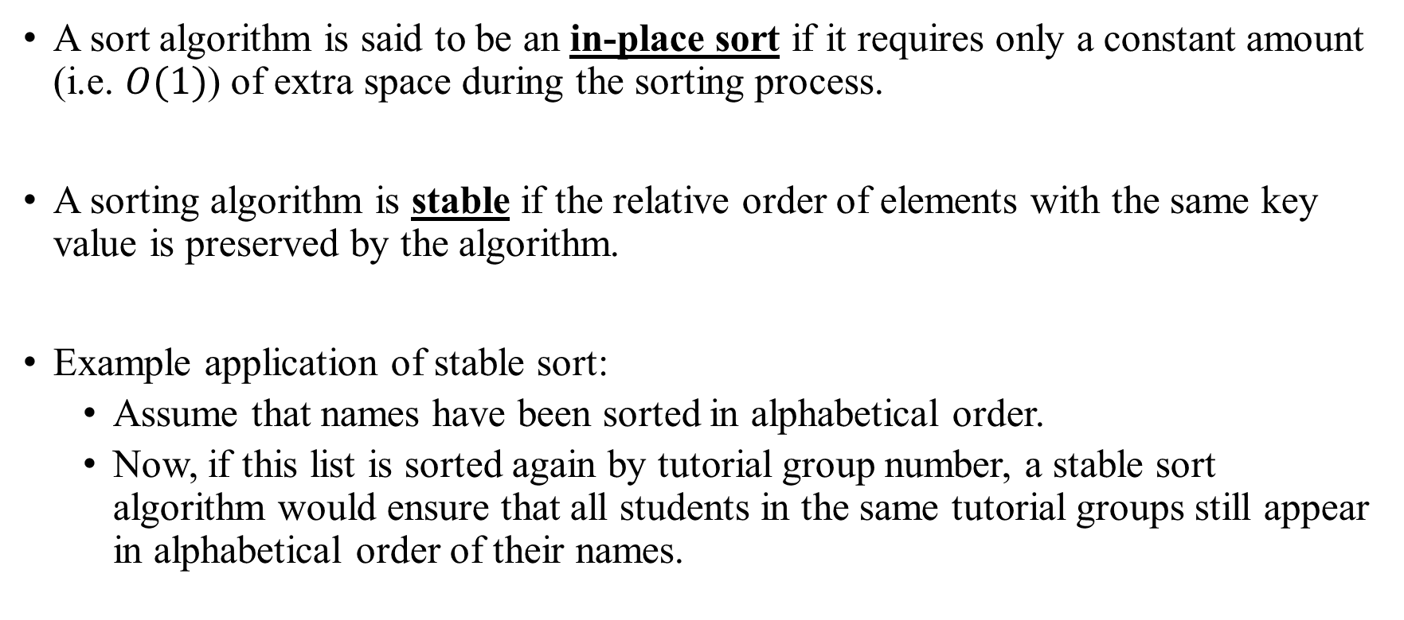
Properties of Sorting
In-place and stable

Slide 3
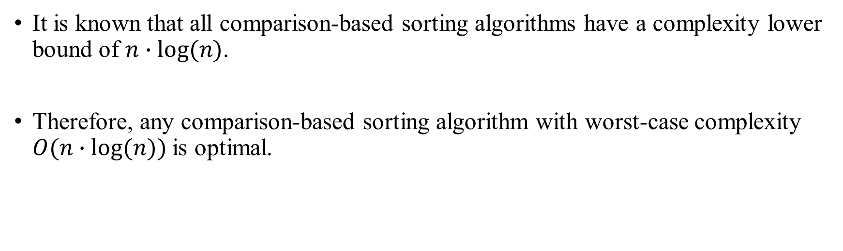
Sortings
Lower Bound: Comparison-Based Sort

